Slide 1


PostgreSQL Indexes

Slide 2

Overview
Boost read performance:
Efficient data structures that speed up data retrieval.
Reduce disk I/O:
By scanning less data, queries become faster.
Trade-off: Slower writes
Indexes need to be updated on INSERT, UPDATE, DELETE operations, which can impact write performance.

Slide 3
Index Types
B-TREE
(default)
GIN
HASH
GiST

Slide 4
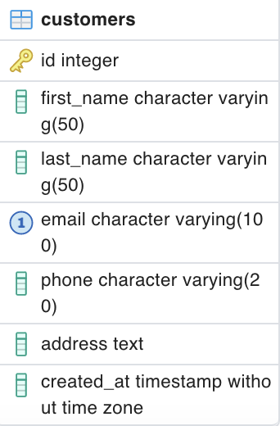
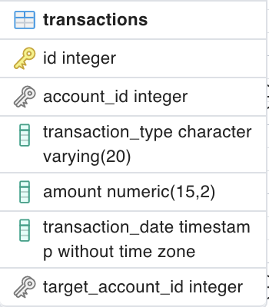
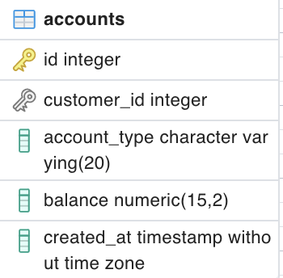
Data Model

Slide 5
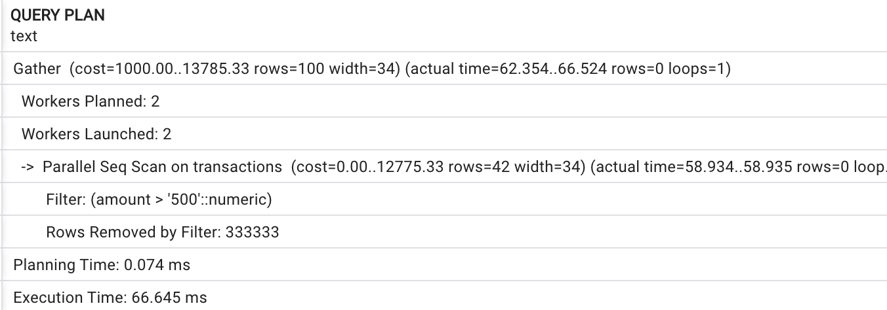
Query without index

Slide 6

Full Table Scan

Slide 7
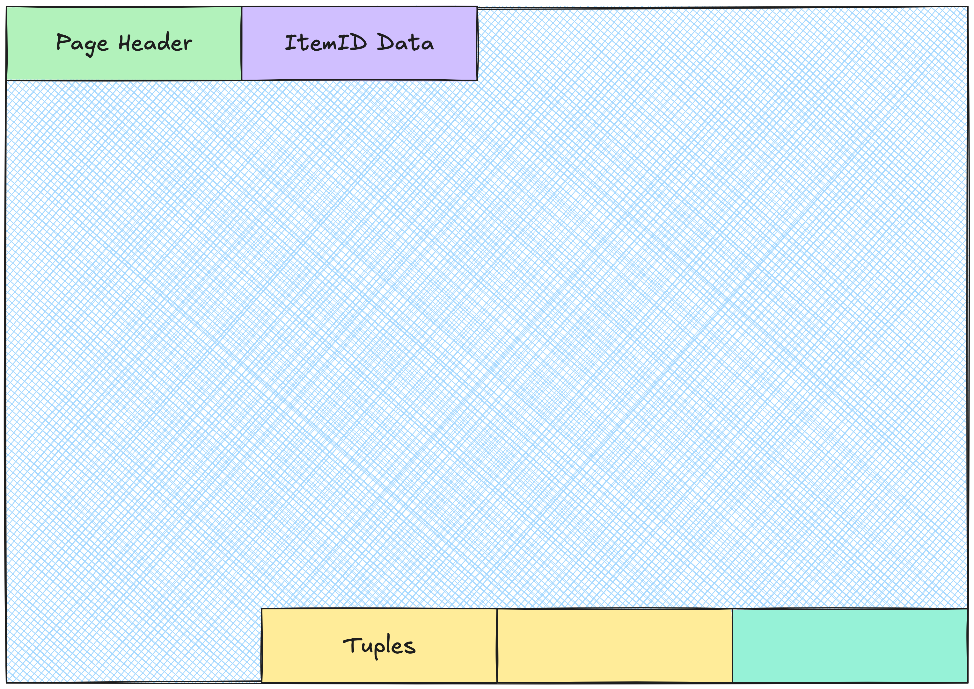
How Postgres stores data

Slide 8
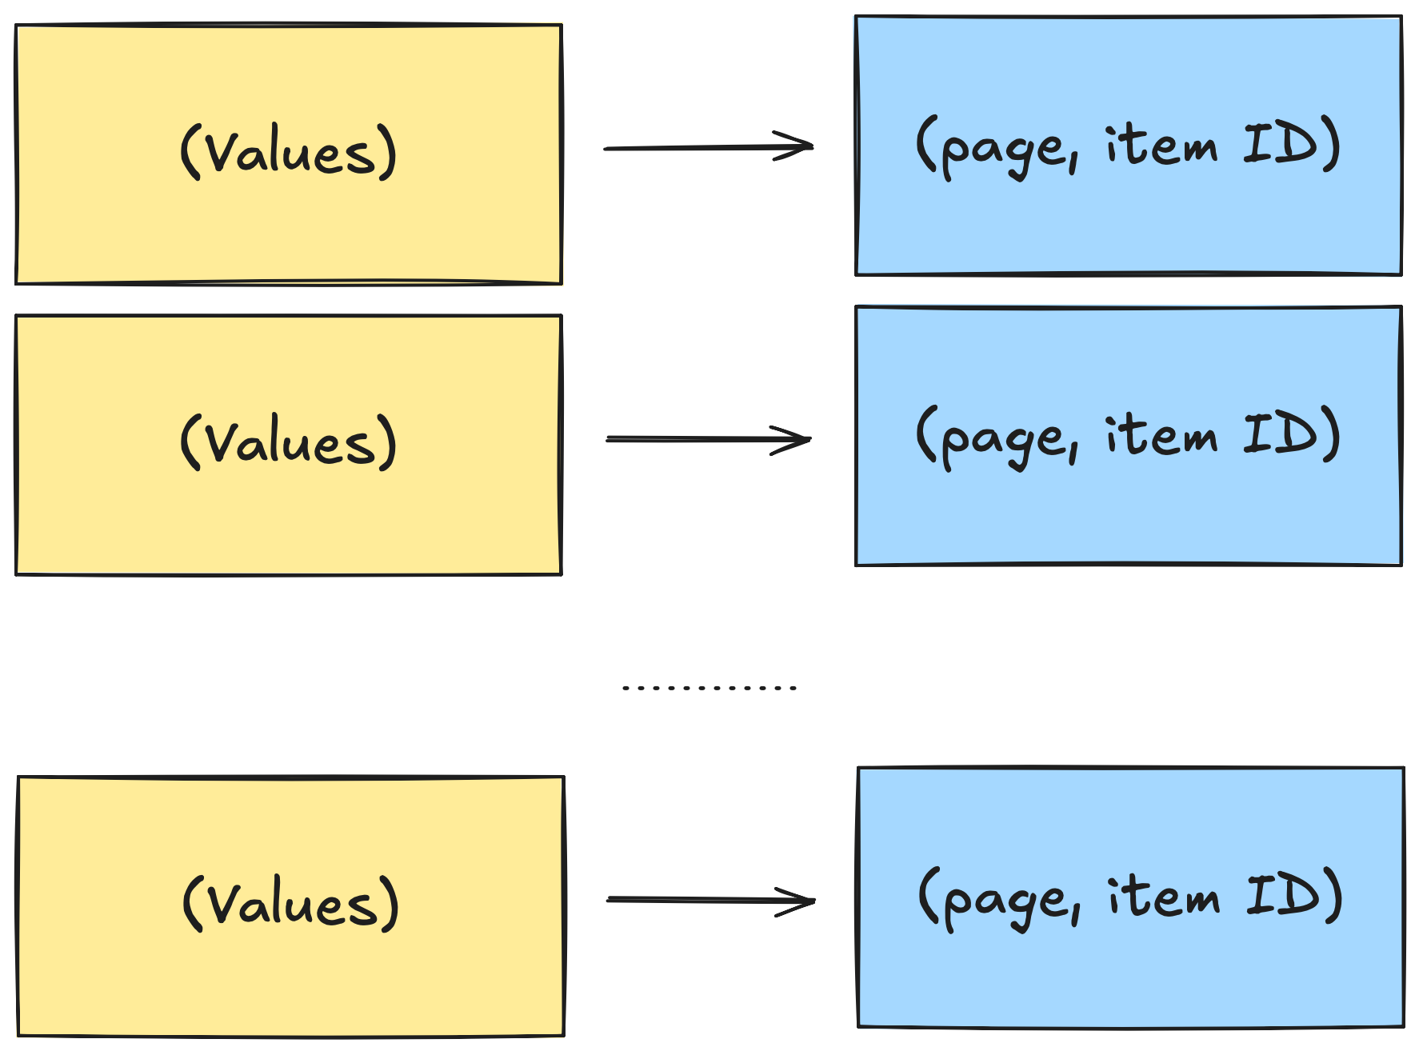
What is an index

Slide 9
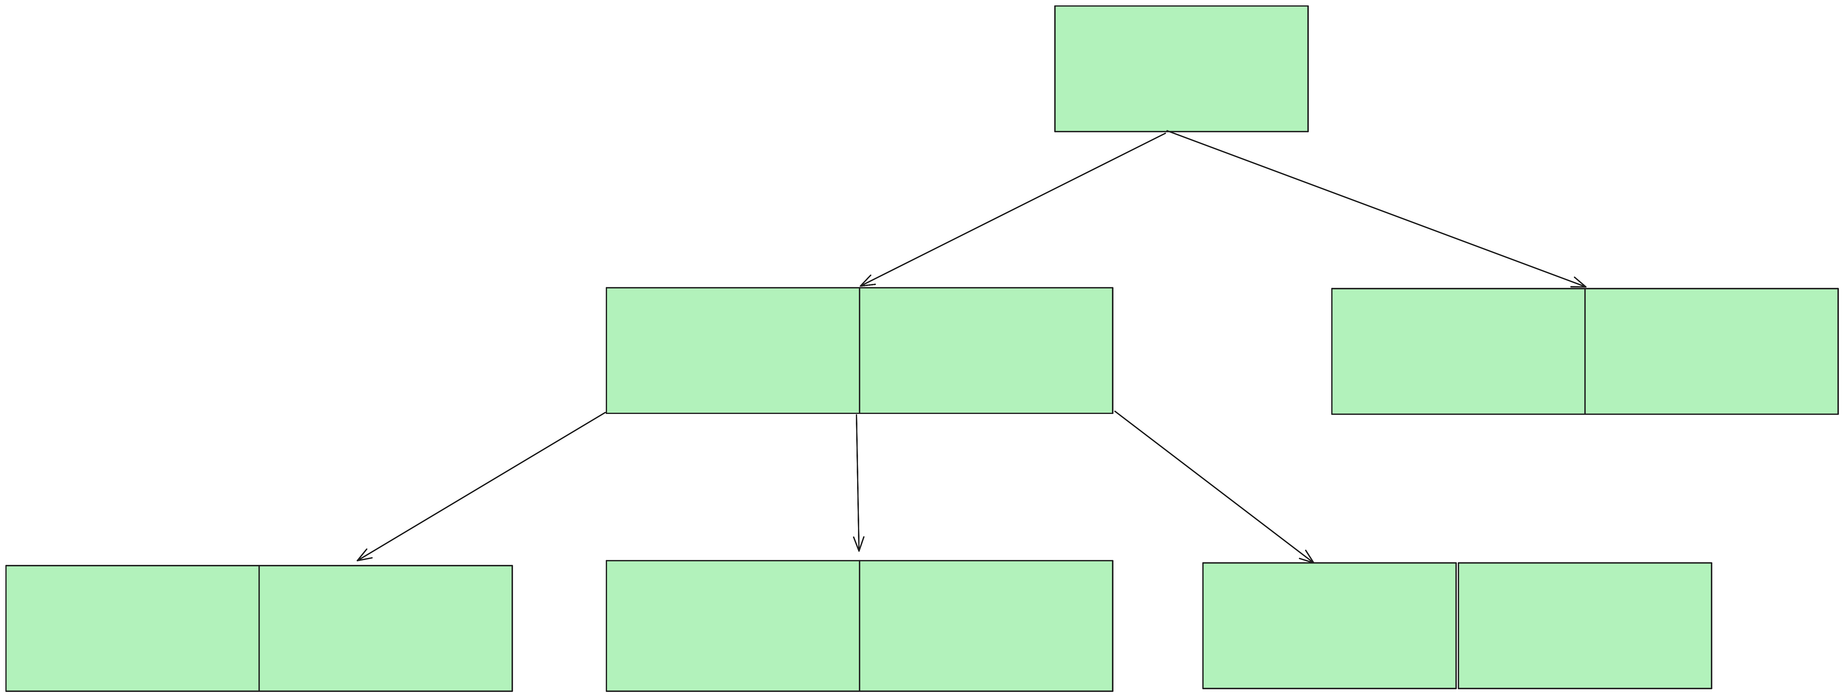
B-TREE
Self-balancing search tree

Slide 10

B+TREE

Slide 11
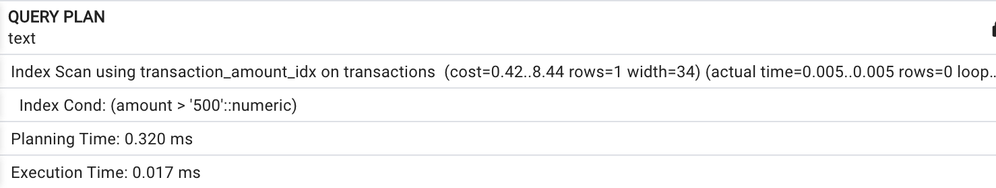
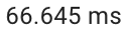
Query with index
was

Slide 12
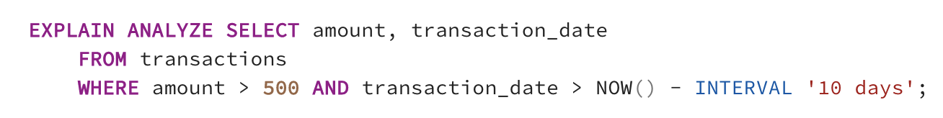
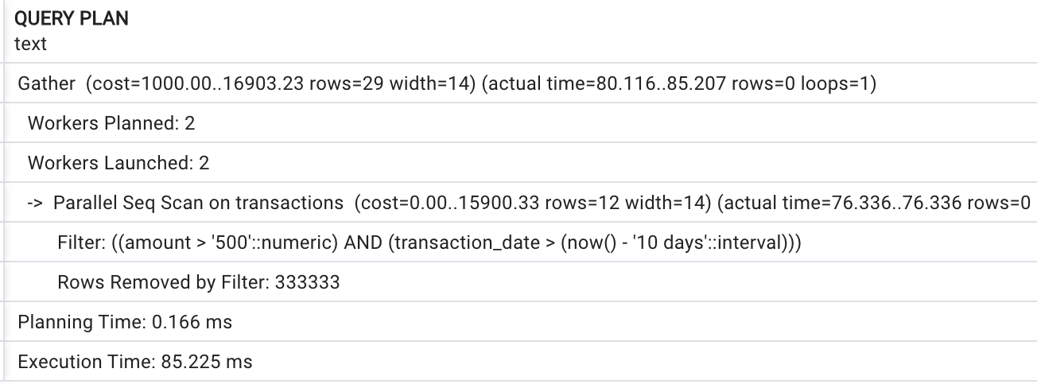
Composite index

Slide 13
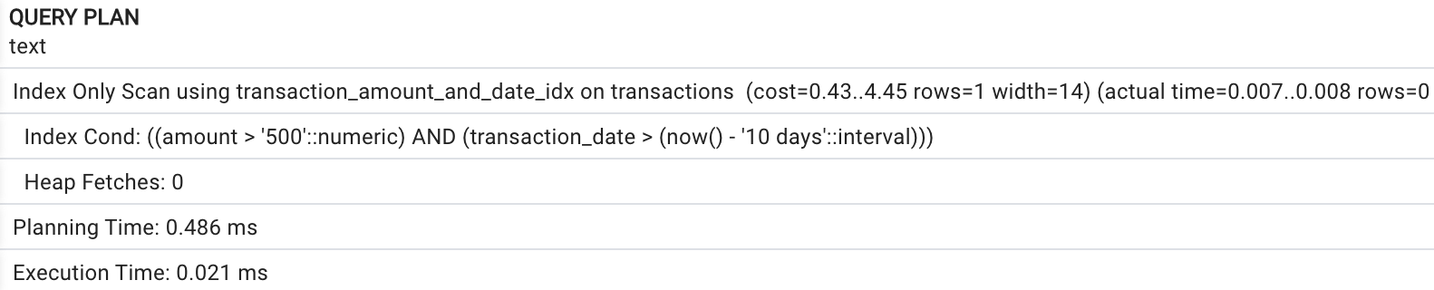
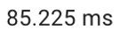
Composite index
was

Slide 14
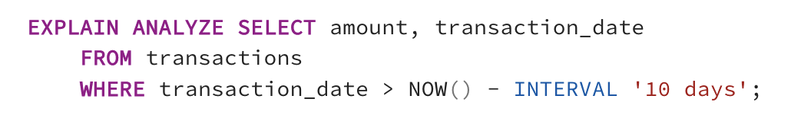
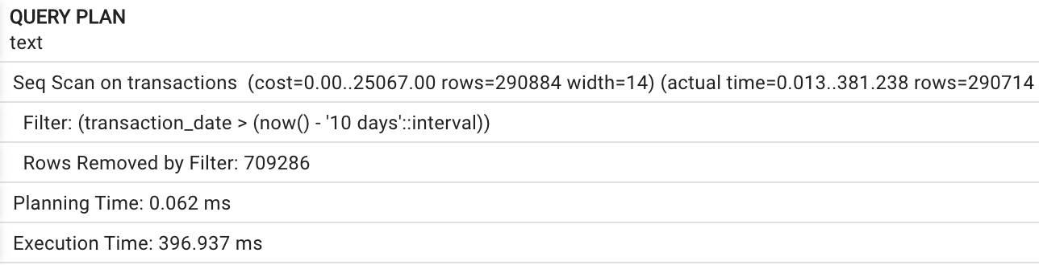
Composite index

Slide 15

Partial Index
”in-progress” – 10%
Reduce the size of the index

Slide 16

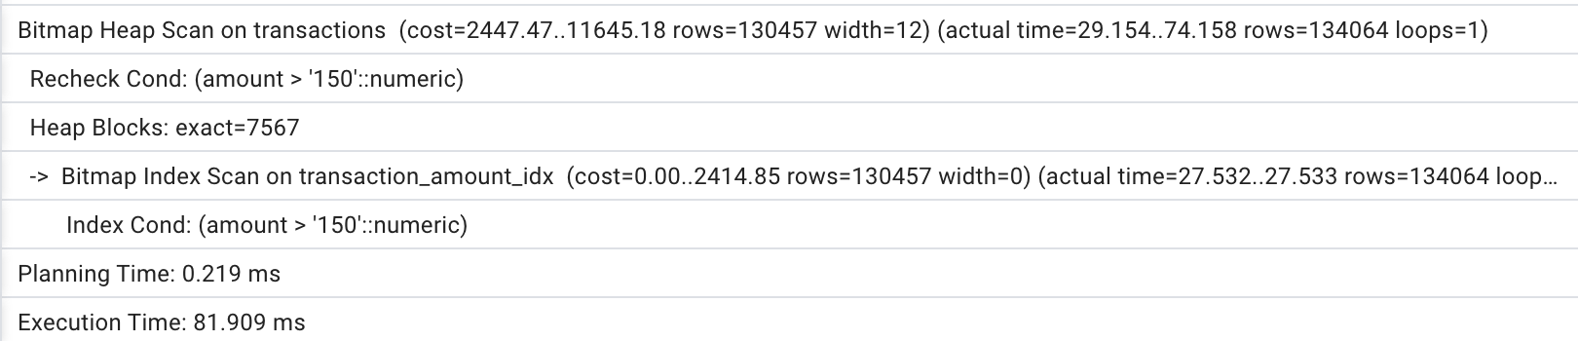
Covering Index

Slide 17
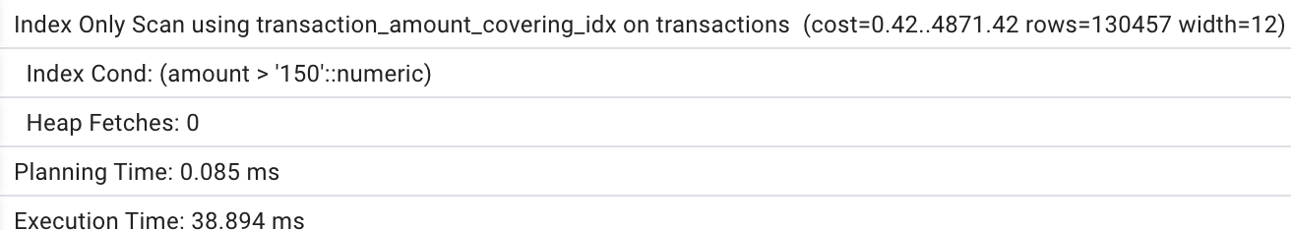
Covering Index

Slide 18

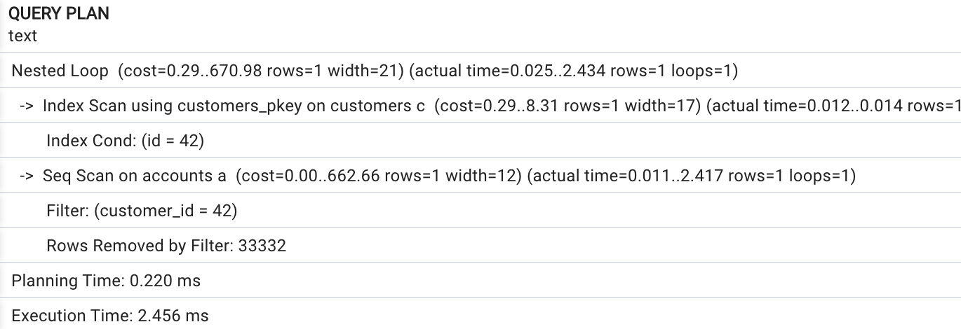
Index on Join Column

Slide 19
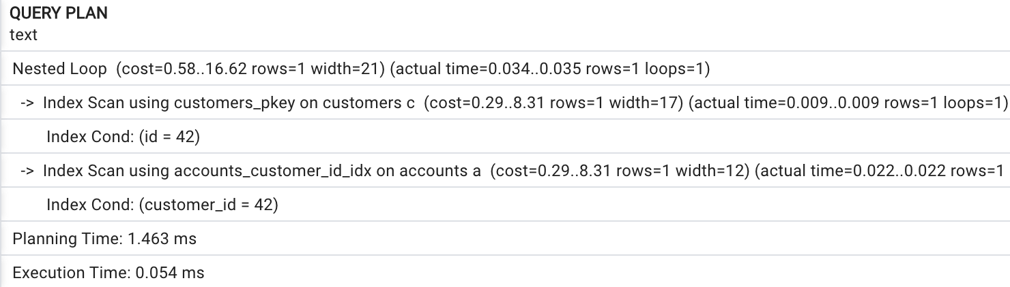
Index on Join Column

Slide 20
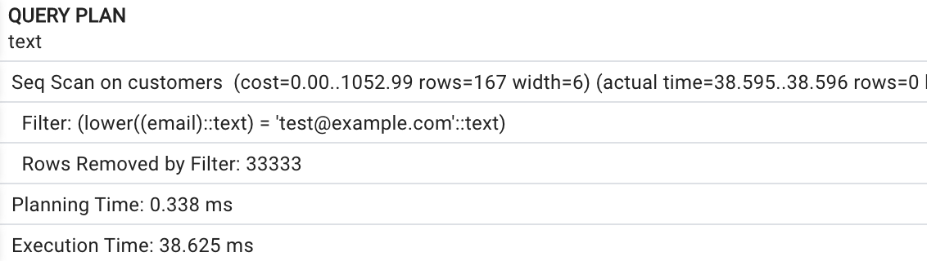
Function Based Index

Slide 21
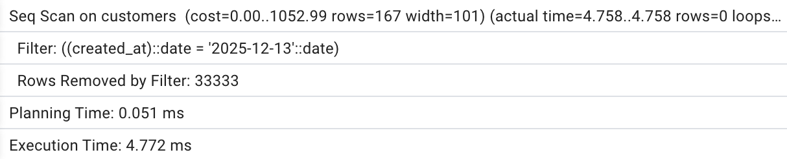
Query With Casting

Slide 22
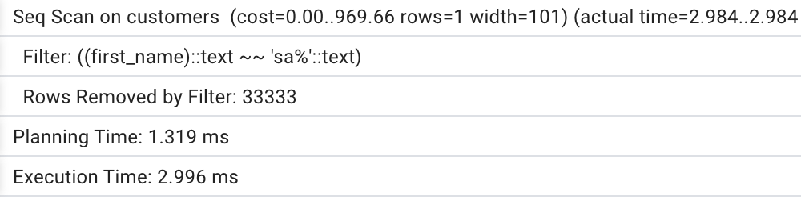
Query With Like

Slide 23

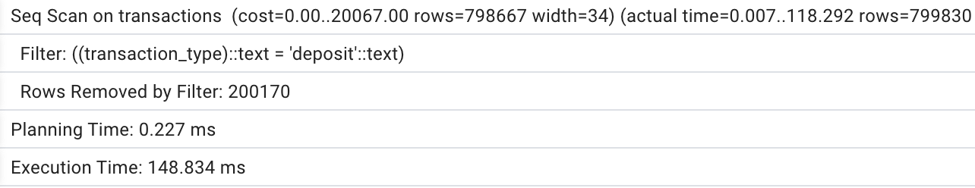
Low Selectivity
The transaction type 'deposit' has a frequency of 80% among all transactions.

Slide 24
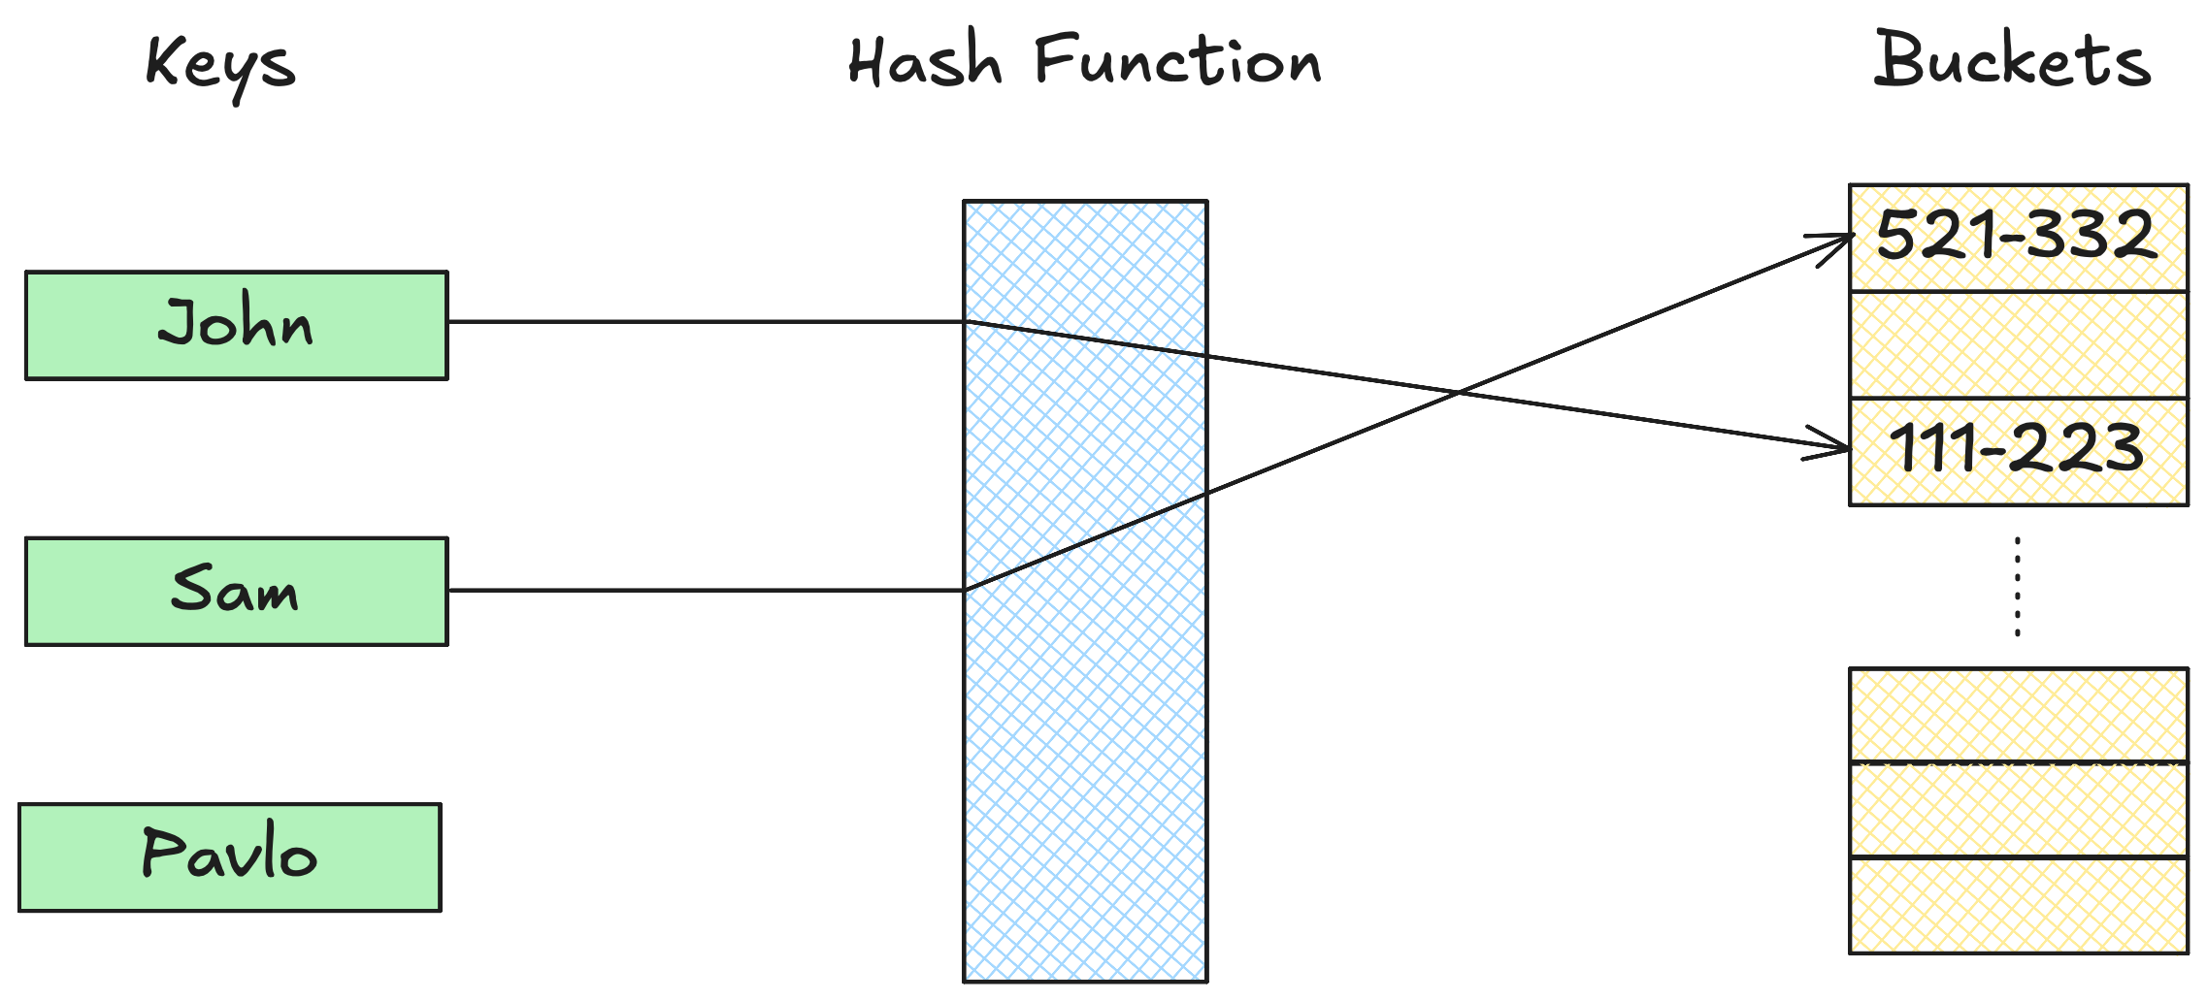
Hash Index

Slide 25
Hash Index
IMPORTANT: Hash index works only with the = operator.

Slide 26

Thank you
Author: Dmytro Halchenko
My LinkedIn: https://www.linkedin.com/in/dmytro-halchenko-0307751b6/
Date: March 2025
Join Codeus community in Discord
Join Codeus community in LinkedIn

